Slide 1
Project Introduction
Building Automation
Curtain Control
Lighting Control
Alarm Collection

Slide 2
Key Requirements
Automatic Open/Close for curtains dependent on work/weekend/vacation.
Gets info from Google Calendar with IfTTT.
Manual control delievered through Tinker app.
Building Automation
Curtain Control
Lighting Control
Alarm Collection
Automatic On/Off for lights dependent on time.
Control of 230 V.
Manual control delievered through Tinker app.
Reverse engineering of a firealarm.
Publish to other Particle devices.

Slide 3
Technical Challenges
3d printing is proving to be a little bit of a hassle.
Setup of webhook/IfTTT.
General construction of the system.
Building Automation
Curtain Control
Lighting Control
Alarm Collection
Wanted component seems a little difficult to get.
Reverse engineering of a firealarm.
Design & Construction of audioelectronics.
Setup of Publish.

Slide 4
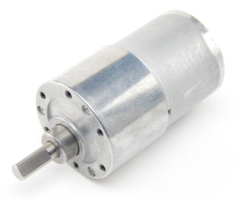
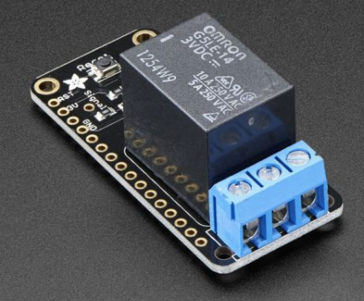
Choice of Sensors & Actuators
DC Motor
Reed sensor/switch.
Building Automation
Curtain Control
Lighting Control
Alarm Collection
Control of 230 V
Old computer microphone.
Audio amplification electronics.

Slide 5
Testing
Testing of software with LEDs.
Testing of 3d printed gears with motor and speed regulating software.
Testing of finished system.
Building Automation
Curtain Control
Lighting Control
Alarm Collection
Testing of software.
Testing of finished system.
Testing of amplification electronics with Analog Discovery.
Testing of finished system.
Then testing that all 3 parts work together as part as a whole.

Slide 6
GitHub

